Slide 1
Gaming the Survey
Kelly Donahue-Wallace, PhD
Josh Yavelberg, PhD

Slide 2
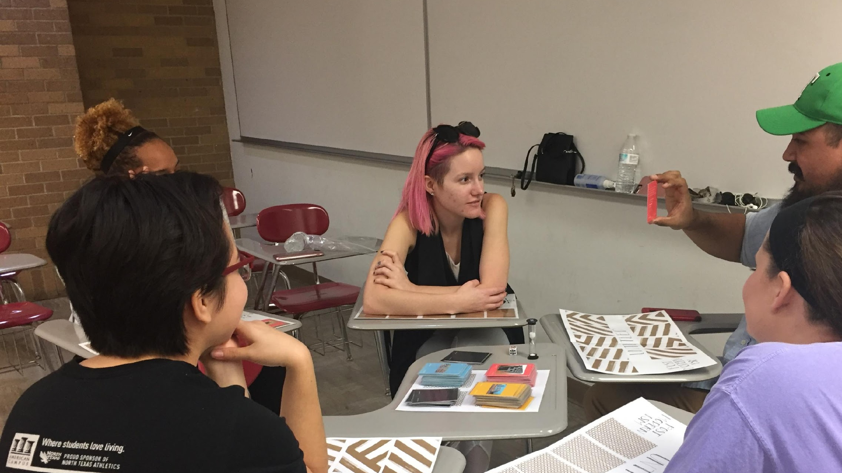
Art History
Survey
Learning Outcomes
Josh Yavelberg, “Discovering the Pedagogical Paradigm Inherent in Introductory Art History Survey Courses, a Delphi Study,” 2016.
Syllabi

Slide 3
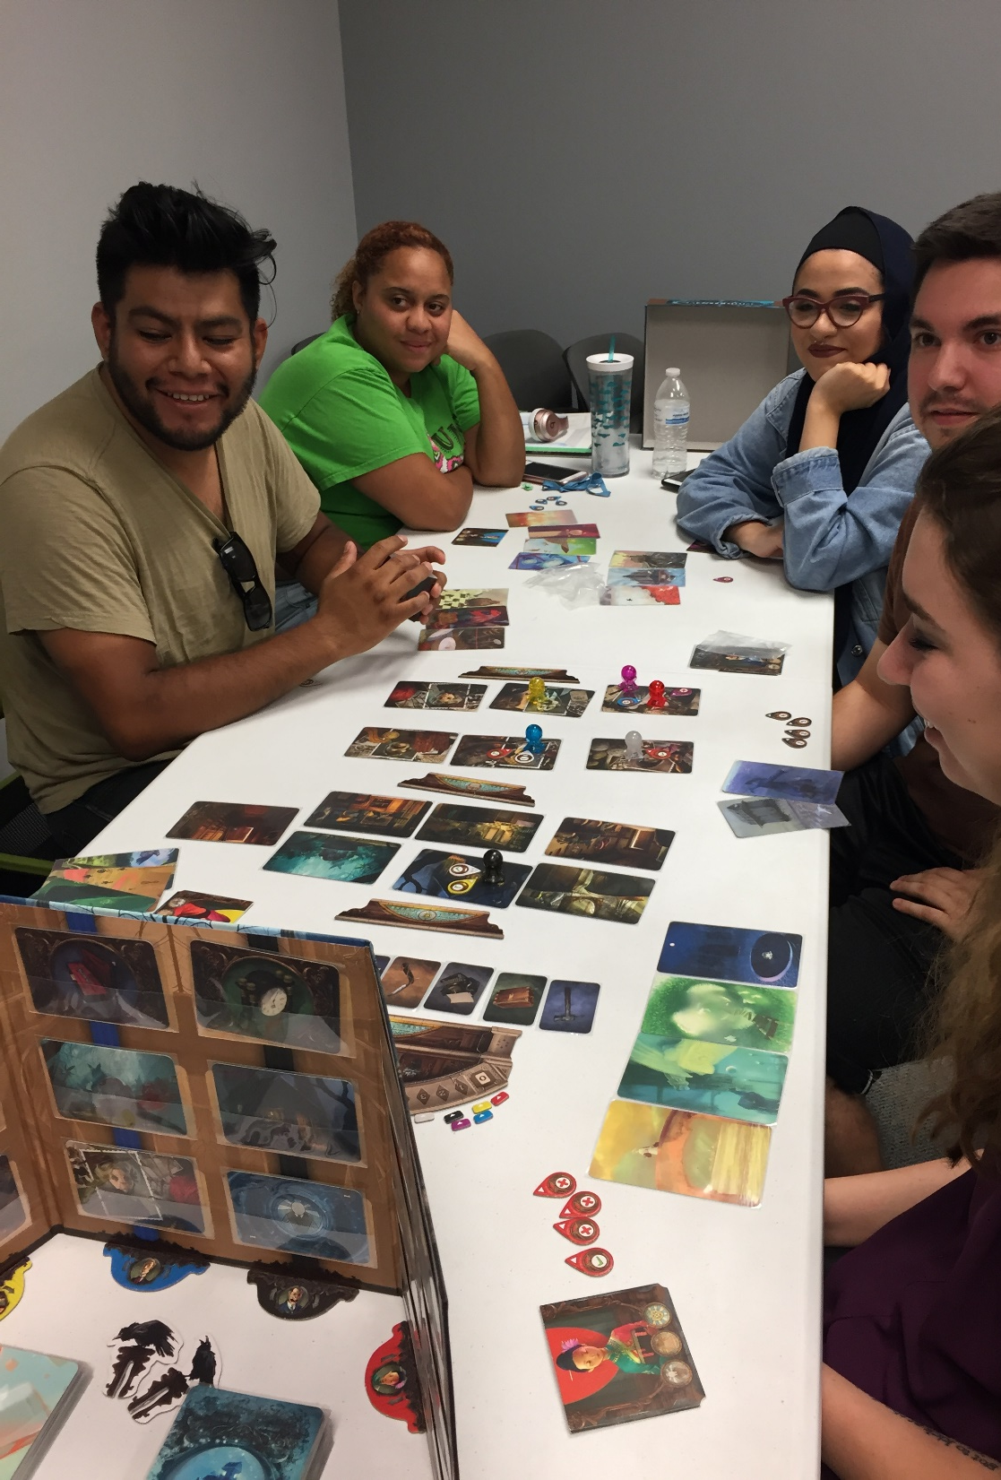
Games
games in general
components of learning games
game design
Sharon Boller and Karl Kapp’s Play to Learn

Slide 4
Methodology
Heuristics
Design-Based Research (DBR)

Slide 5
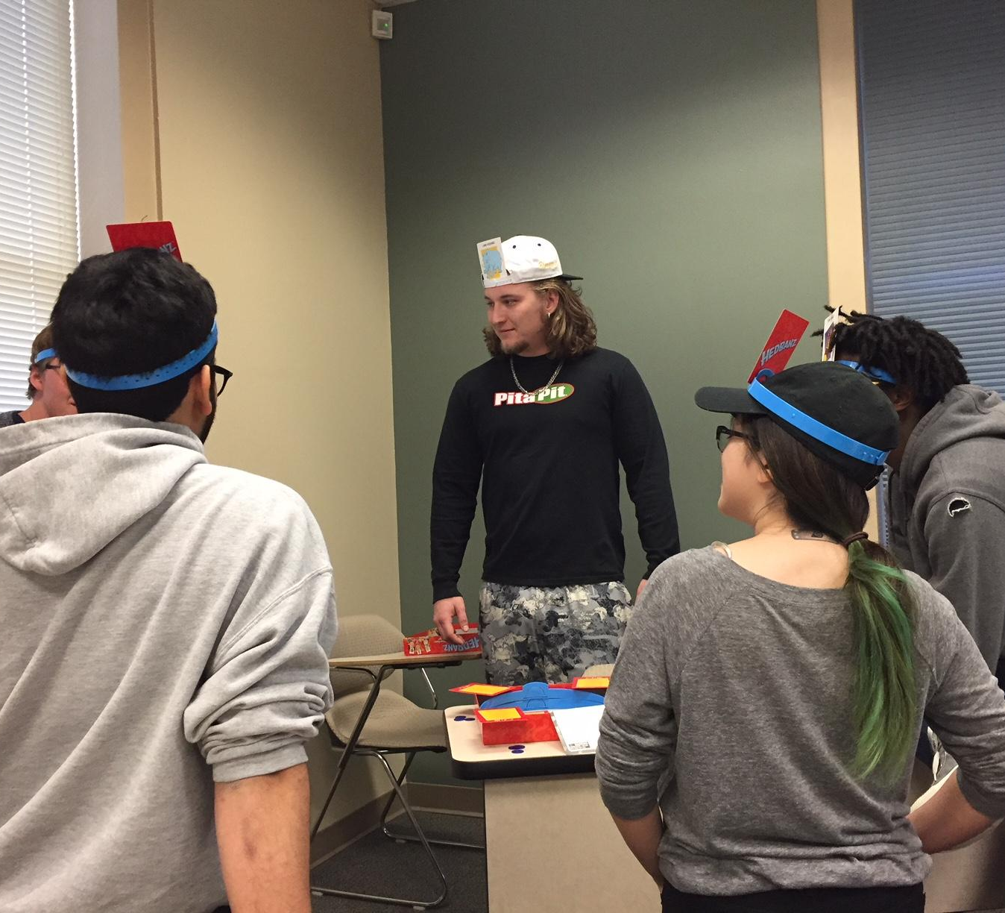
Project Management
Gantt Chart
Schedule of Deliverables

Slide 6
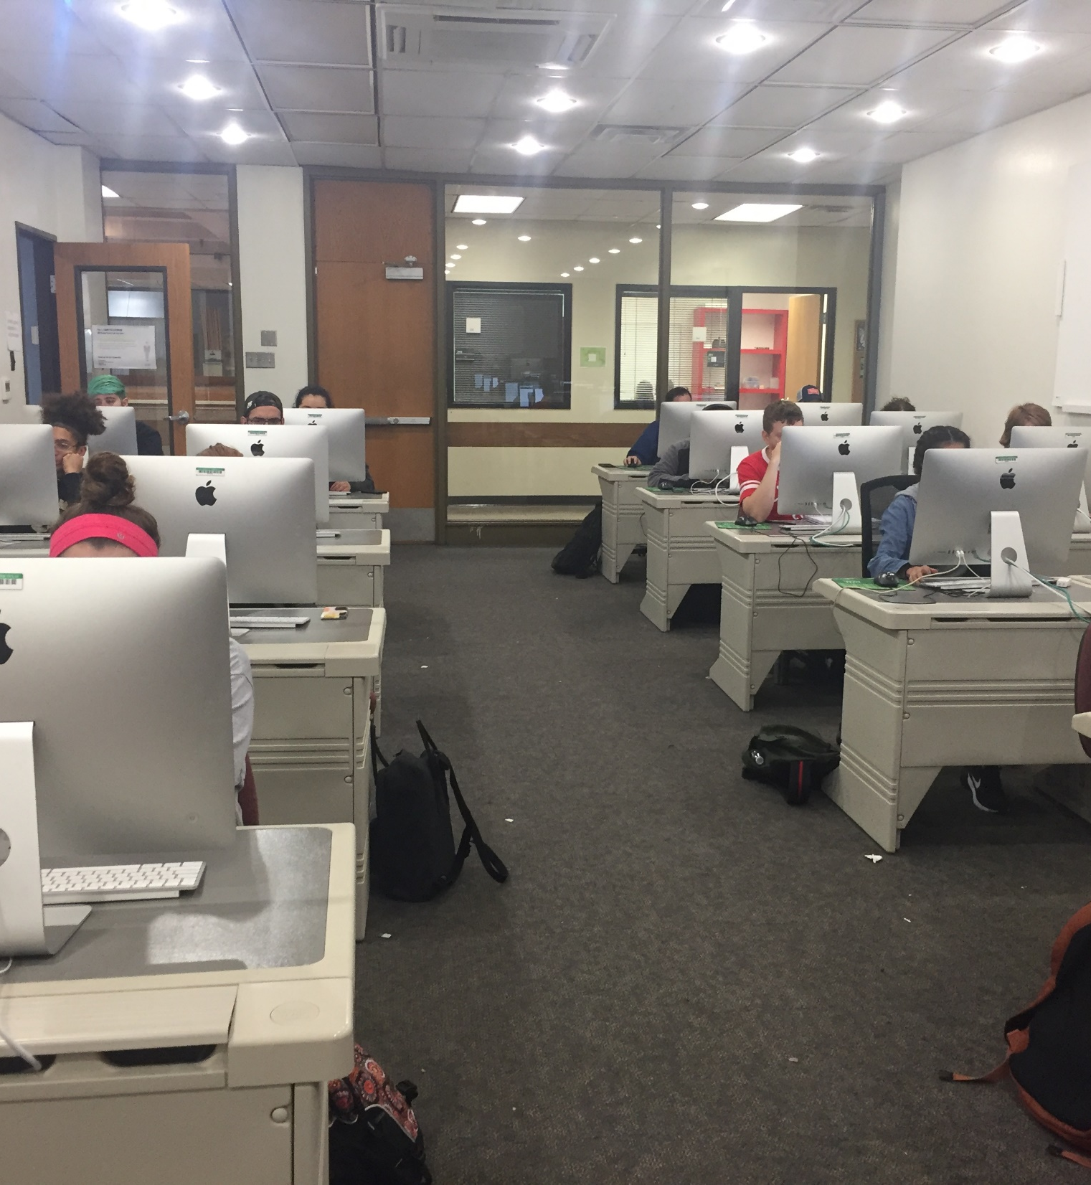
Deliverables
Match Core Dynamics of Game to Learning Needs
Link Game Mechanics to Learning Needs
Select Game Elements
Match Scoring the Learning Goals
Create the Prototype
Play Test and Gather Feedback
Develop the Final Version of the Game
Write a 30-second elevator pitch and a 2-minute description.
Deploy and be ready to present it to an audience in a presentation supported by your playtesting data.

Slide 7
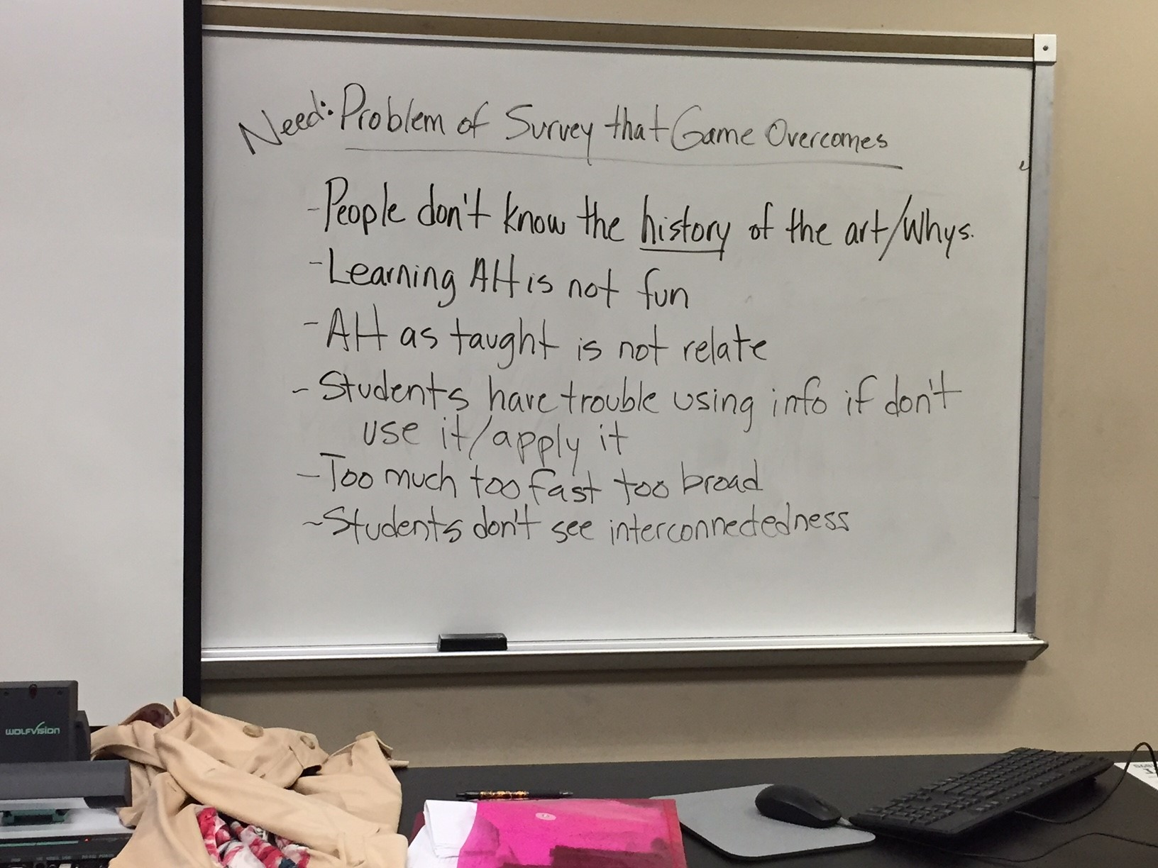
The Students
Demographics
Initial perceptions of the survey

Slide 8
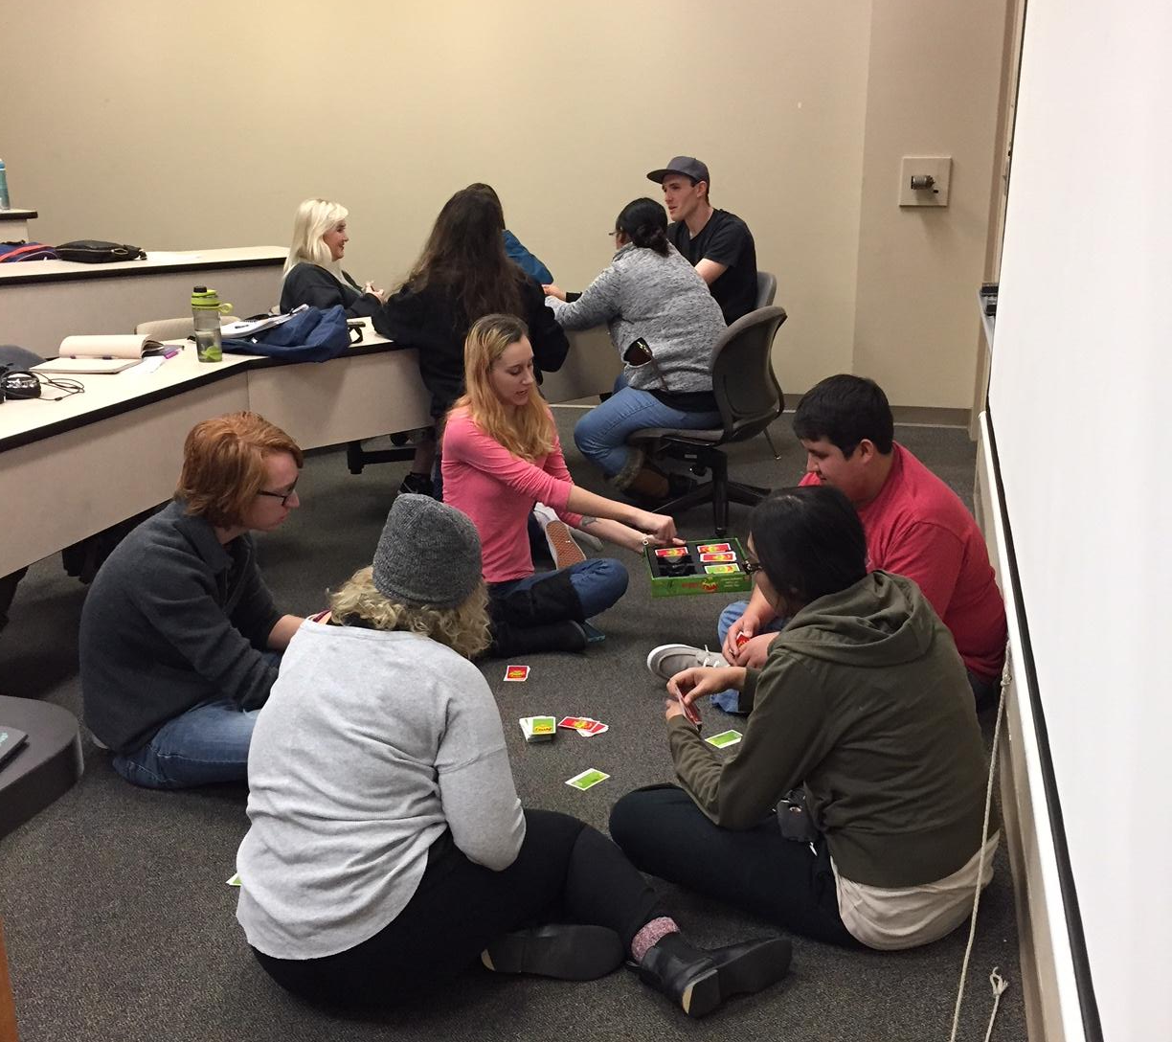
In-Class Work
In teams
All-team meetings

Slide 9
Play Testing with Volunteers

Slide 10
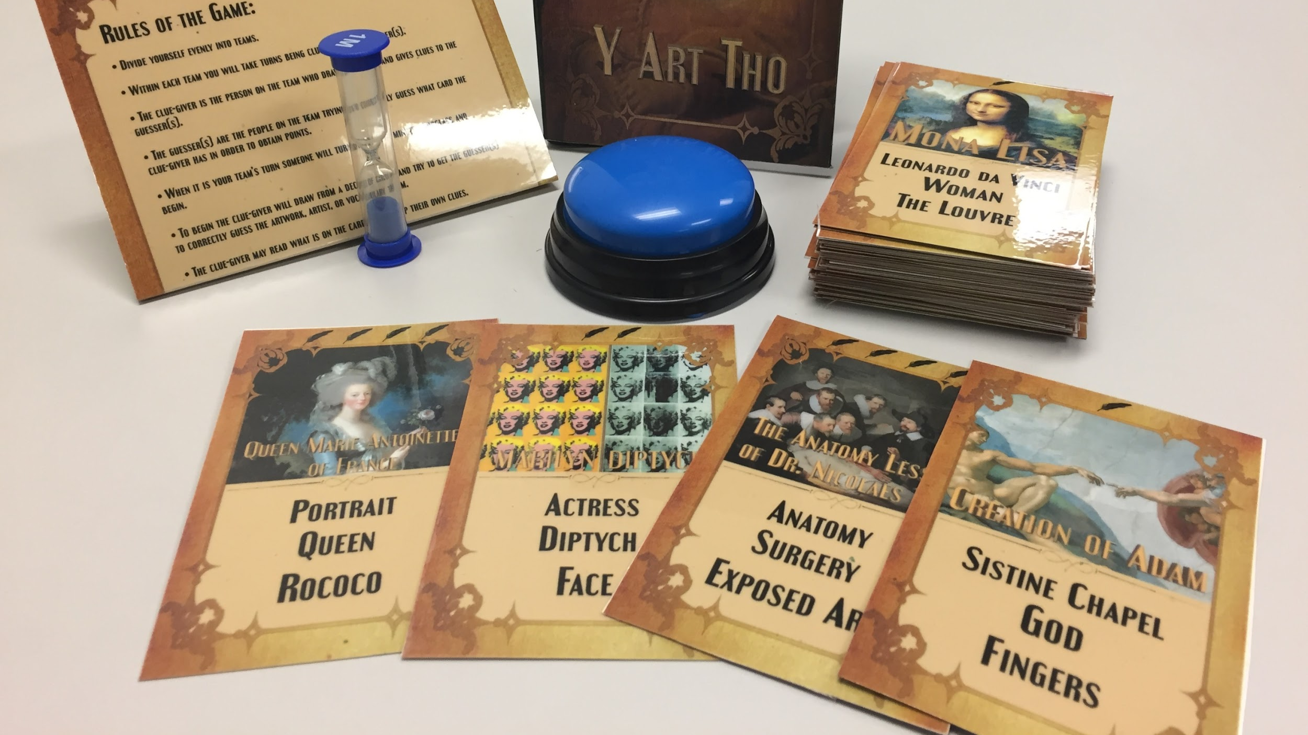
Y Art Tho
Recall the work of art from a study set based on terms/information used to explain it.

Slide 11
Artpocalypse
Collect art by correctly answering questions.
Race to the finish

Slide 12
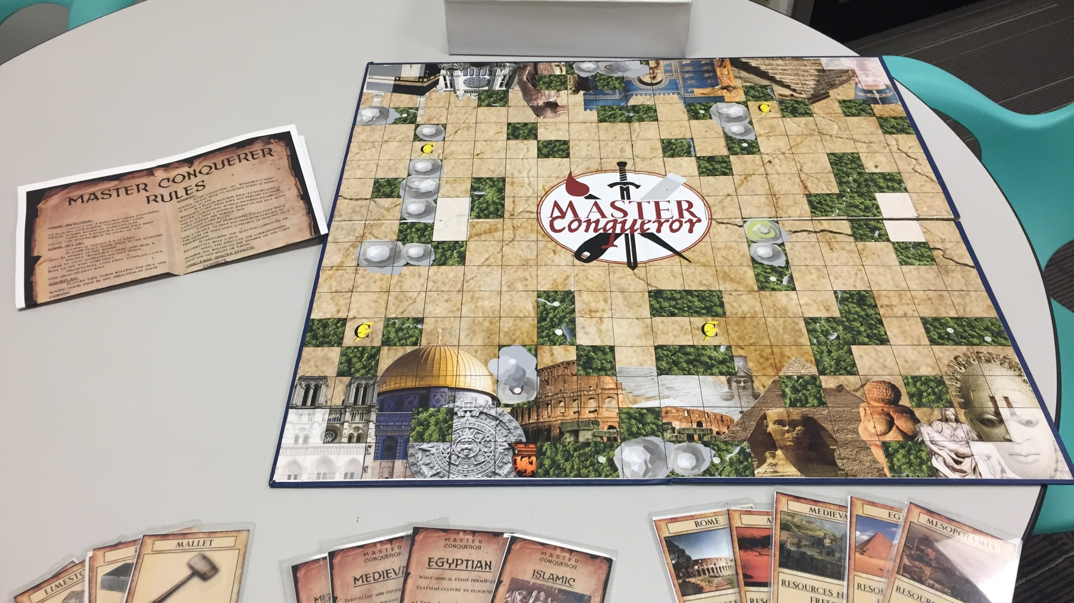
Master Conqueror
Become a civilization and expand influence through visual artifacts

Slide 13
Exhibition
Trivial pursuit style collection game

Slide 14
Untitled
Flashcard-based game testing understanding and application of terminology

Slide 15
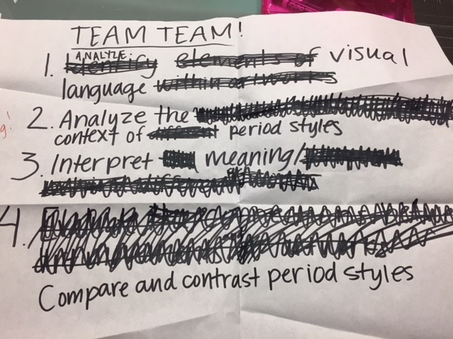
Reflection

Slide 16
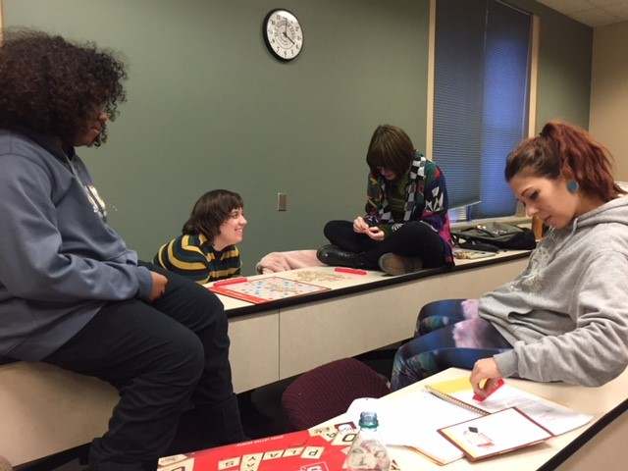
Continuing the Effort…
A new semester!

Slide 17
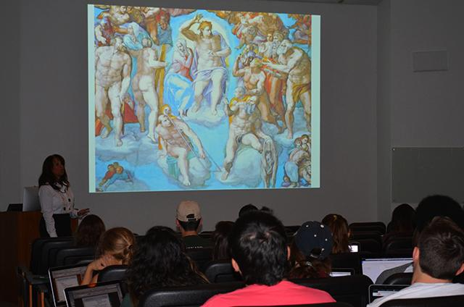
Implications & Future Research
Implement learning games developed in survey course
Studies focusing on student understanding of learning outcomes

Slide 18
Gaming the Survey
Kelly Donahue-Wallace, PhD
Josh Yavelberg, PhD
THANK YOU!

